Slide 1

online organ donation management SYSTEM

Slide 2
contents
Project Profile
Hardware Interface
Software Requirements
Entity Relationship Diagram
Problem Statement
Existing System and Proposed System
Possible Outcomes
Database Tables

Slide 3
PROJECT PROFILE
Project Title: Online Organ Donation Management System
Project Guide: Mr.Abhijeeth Das and Mrs Nita
Front End: css, html,php
Back End: wamp
Team Size: 2
Team Members : Bhoomika.S and Keerthana.S

Slide 4
Hardware interface
We require LAN connection for interacting with data base and local computers for any help or any other requirements. We use TCP/IP protocol for communicating with local hosts.
Hardware processor: Intel core i5, 7th Gen
RAM: 4GB DDR4 RAM
Hard Disk: 20GB or more

Slide 5
Software interface
1. Software requirements are
2. Operating System : Windows 10
3. Software programming languages used are
HTML
Cascading Style Sheet
PHP
My SQL database (Wamp Server)

Slide 6
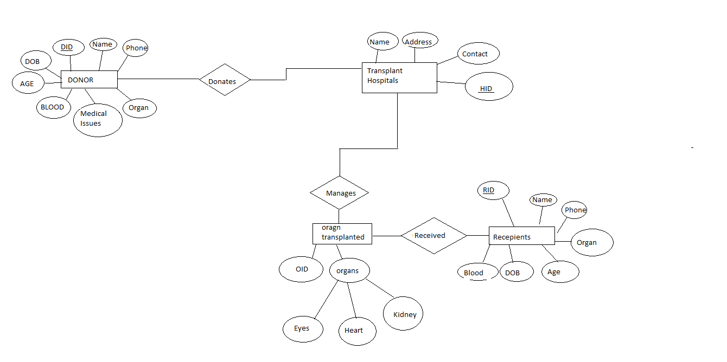
Entity relationship diagram

Slide 7
PROBLEM STATEMENT
Lack of an appropriate organ donor is a frequent problem faced by the people. This can be overcome if deceased organ donation is implemented in a proper manner.
India has only 301 hospitals that can perform organ transplantation. Out of which 250 have registered with NOTTO (national organ and tissue transplant organization). Which means to conduct an organ transplant, there exist one fully equipped hospital for around 43 lakh people.
Lack of education awareness among general public about organ donation, organ donation cards, process of organ donation add to the superstitions and misconceptions associated with organ donation in our country and make the organ donation a tedious task.

Slide 8
EXISTING SYSTEM AND PROPOSED SYSTEM
Godrej HIT
NHS organ donation
Www.Donatelifeindia.Org
These are the apps for online registration as an organ donor.
Mainly it is required to create awareness to contribute to save people’s lives.
There are only 0.16 organ donors per million people in India.
One donor could save not 1, but 8 lives at a time. A tissue donor can save 50 lives. As is outlined in this presentation, we strongly believe that the implementation of these pathways for obtaining organs from the living and the dead donors, with appropriate consideration of the ethical, religious and social criteria of the society, the organ shortage crisis will be eliminated and many lives will be saved through the process of organ donation and transplantation. Hence, we require a proper organ donation management system.
Proposed system
Easy for the users to donate and receive organs
Avoid the manual work.
Becoming a donor is easy.

Slide 9
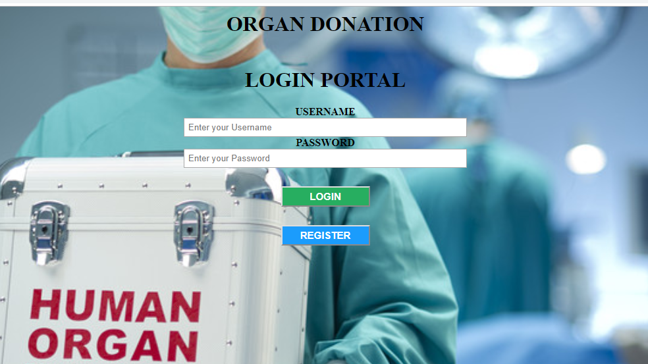
Possible outcomes

Slide 10
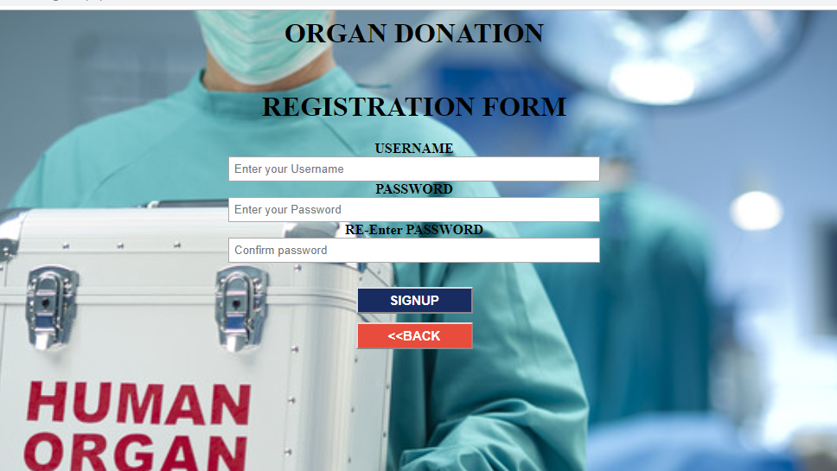

Slide 11
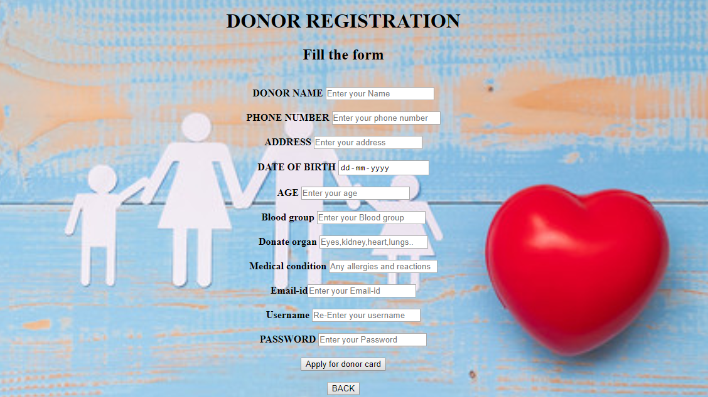

Slide 12
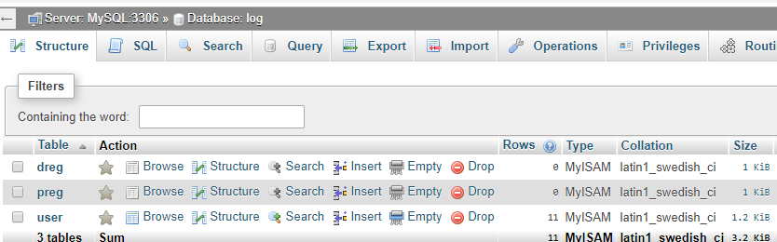
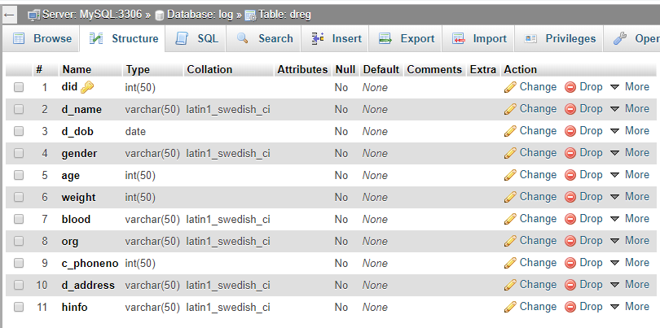
Database tables

Slide 13
